Slide 1
Crisis Management and Recovery for Events: Issues and Directions
Ziakas, Antchak & Getz

Slide 2
Stages in Event Crisis Management
Awareness
Acknowledgement or Denial
Anger and Bargaining
Leadership and Decision-making
Reaction and Planning
Innovation, Creativity and Resilience

Slide 3
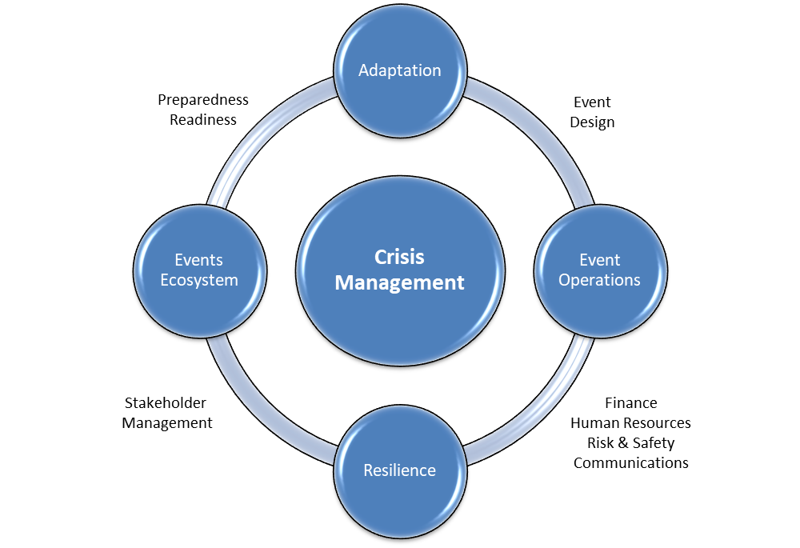
A Rounded Crisis Management Framework for Events

Slide 4
Key Trends and Structural Transformations
(1) the weakened economy, including a decline in globalization
(2) the nature of work
(3) leisure and tourism
(4) social and cultural change

Slide 5
Towards Chaordic Event Crisis Management: Connecting the Fragments
Chaordic Event
Crisis Management
Adaptive Response & Self-organizing
Portfolio Management
Transformation
Destination

Slide 6
Questions for Future Research
In the post-pandemic period, will the events sector and ecosystem be the same, or have structural changes occurred? What are they?
Will hybrid and virtual events threaten the status quo, or will the sector return to its emphasis on live events? What are the implications of hybrid and virtual events for work/careers, revenue generation, audiences' experiences and satisfaction, and stakeholder support?
How many events will have failed, and are there now gaps to be filled through innovation?
Which types of events will be prioritized by cities and destinations in the recovery stage (with implications for public, private and nonprofit sectors)?
What are the implications of the pandemic crisis for education, training and careers in the events sector? How can students and practitioners be prepared for crisis management and worst-case scenarios?
What new forms of collaboration and stakeholder networking have emerged? Do these fit into the concept of event portfolio management, or enlarge it?
Has the well-being of workers, volunteers, owners and other stakeholders suffered during the pandemic? What are the implications for the future of education, training, work and careers?
Will events return to basics and adopt new, more conservative business models? Can new revenue streams be developed?
How should crisis and risk management evolve?
Has the pandemic focused or re-directed attention on value co-creation, and in what ways?
New collaborations have been forged and new stakeholders brought to the fore. What are the implications for event and portfolio governance? What forms of collaboration and portfolio management are most effective and efficient in terms of sustainability and resilience?
Stages of crisis response, recovery and resilience building have now been hypothesized and they need to be verified or amended through empirical research in many settings; what explains differences in decision-making, for example?
Research and theory development are required with regard to chaos theory and chaordic systems applied to events and event populations. What are the optimal pathways and events ecosystem configurations that lead to effective crisis management and recovery?
How does the Maturity model of the event sector relate to sustainability and resilience?

